Slide 1
From our previous call in week 2
From our previous call in week 3
Intro to Data Frames
Creating/Removing Columns
For loops, While loops
Defining custom functions
range()
Apply these to data frames
User defined function | Anonymous (Lambda) function
Easy to interpret | Interpretation might be tricky
Supports any number of lines inside a function block | Supports single-line sometimes statements that return some value.
Good for any cases that require multiple lines of code. | Good for performing short operations/data manipulations.
We can use comments and function descriptions for easy readability. | Using the lambda function can sometime reduce the readability of code.
Do not return anything if not explicitly returned | No need to have return keyword defined explicitly because the lambda function does return an object by default
 | lambda functions are syntactically restricted to a single expression.
Execution time is relatively slower for the same operation performed using lambda functions | Execution time of the program is fast for the same operation

Slide 2
User defined function | Anonymous (Lambda) function
Easy to interpret | Interpretation might be tricky
Supports any number of lines inside a function block | Supports single-line sometimes statements that return some value.
Good for any cases that require multiple lines of code. | Good for performing short operations/data manipulations.
We can use comments and function descriptions for easy readability. | Using the lambda function can sometime reduce the readability of code.
Do not return anything if not explicitly returned | No need to have return keyword defined explicitly because the lambda function does return an object by default
 | lambda functions are syntactically restricted to a single expression.
Execution time is relatively slower for the same operation performed using lambda functions | Execution time of the program is fast for the same operation

Slide 3
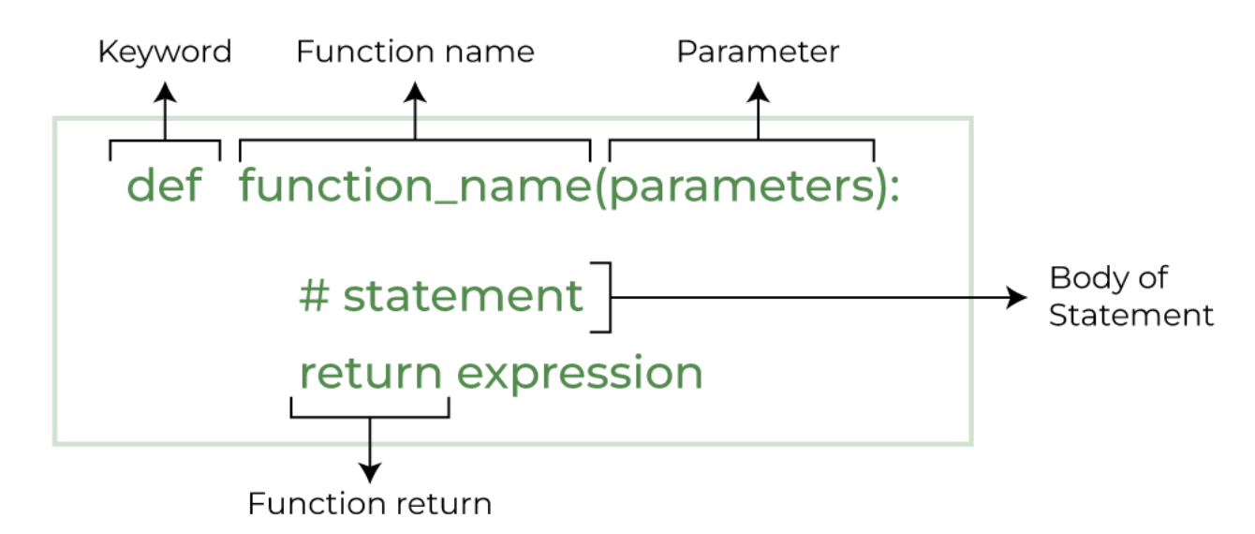
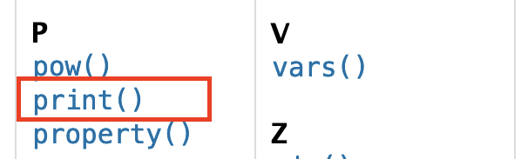
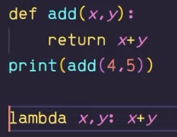

PYTHON FUNCTIONS
BUILT-IN
USER DEFINED
ANONYMOUS (LAMBDA)
Library functions
To reduce complexity of big programs
Are similar to user-defined functions but without a name.
They are efficient whenever you want to create a function that will only contain simple expressions
SYNTAX
SYNTAX
SYNTAX
Are made to be pasted into higher order functions
Varies by function
lambda [args] : expression
Example
Example
Example
1
2

Slide 4
Tuples ( , ,) | Lists [ , ,] | Sets { ,,} | Dictionaries { :, :,}
tuple1=(1,2,"college",9) | list1=[1,4,"Gitam",6,"college"] | set1={1,2,3,4,5,"hello","tup"} | dict1={"key1":1,"key2":"value2",3:"value3"} dict3=dict({1:"apple",2:"cherry",3:"strawberry"})
A collection of ordered data | A collection of ordered data | A collection of unordered data | A collection of unordered data that stores data in key-value pairs.
Accepts different data type | Accepts different data type | Accepts different data type | Accepts different data type
 |  | Does not allow duplicate values | Allows duplicated values, whereas keys can’t be repeated
Immutable | Mutable | Immutable | Mutable
 | Unlike Sets, a list doesn’t need a built-in function for its creation of a list.
An element cannot be added to the tuple as it is immutable. | adds a single item at the end of the list without modifying the original list. | The set add() method adds a given element to a set. | The update() method updates the dictionary with the specified key-value pairs
sequence type | sequence type |  | NOT sequence type
Sequence types and mutability
A sequence type is a type of data in Python which is able to store more than one value (or less than one, as a sequence may be empty), and these values can be sequentially (hence the name) browsed, element by element.
As the for loop is a tool especially designed to iterate through sequences, we can express the definition as: a sequence is data which can be scanned by the for loop.
Mutable data can be freely updated at any time − we call such an operation in situ.

Slide 5
DICTIONARY { }
set { }
LIST [ ]
TUPLE ()
update()
pop()
popitem()
del dict[ ]
clear()
get()
items()
keys()
values()
copy()
fromkeys()
setdefault()
add()
update()
pop()
remove()
discard()
clear()
copy()
union()
intersection()
difference()
issuperset()
issubset()
isintersection()
isdisjoint()
Insert()
append()
extend()
pop()
remove()
clear()
copy()
reverse()
index()
sort()
count()
+
+=
Index()
sorted()
count()

Slide 6
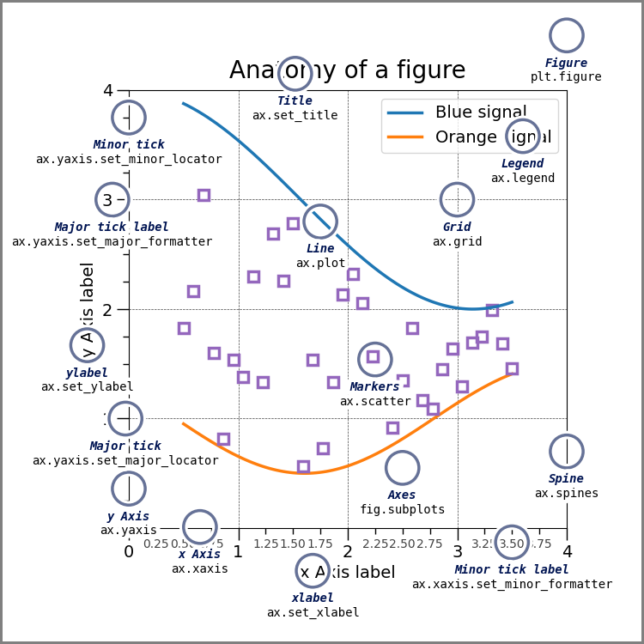
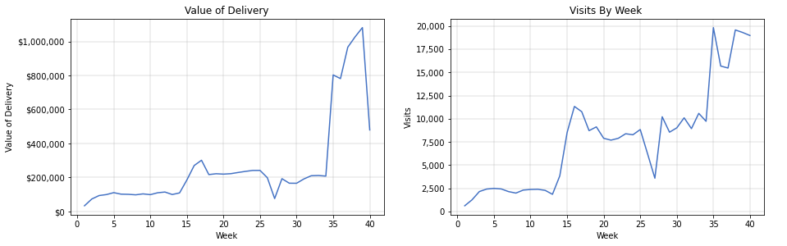
fig = plt.figure() # an empty figure with no Axes
fig, ax = plt.subplots() # a figure with a single Axes
fig, (ax1, ax2) = plt.subplots(2,1) # a figure with two Axes
fig, axs = plt.subplots() # a figure with a 2x2 grid of Axes

